Slide 1
Monitoring points in the Dominican Republic for the IDB - update
Project Personnel :
Michael Gomez Selvaraj & team
Crops for Nutrition and Health
Phenomics Platform

Slide 2
Work plan schedules\Timeline
Goals | Month 1 |  |  |  | Month 2 |  |  |  | Month 3 |  |  |  | Month 4 |  |  |  | Month 5
 | 1 | 2 | 3 | 4 | 1 | 2 | 3 | 4 | 1 | 2 | 3 | 4 | 1 | 2 | 3 | 4 | 1 | 2 | 3 | 4
Development of the research concept and work plan
Identification of availability of satellite images for the study area and quality check
Progress report at the end of the first month
Data pre-processing, creation of IVs, extraction and analysis of features
Generation of trends for each crop with their respective IVs
Progress report at the end of the third month
Hedge usage change and trend analysis
Validation with 2014 and 2019 PATCA data
Preparation of the final technical report
Final report

Slide 3
Data Correction

Slide 4
Corrected IDB data
633 original data
4 data without coordinates
105 data with the same spatial point
73 data in rest field for 2011
Table 1. Number of points per crop
Crops | Count | Percent
Pasto | 143 | 32.87356
Rest field | 73 | 16.78161
Platano | 42 | 9.655172
Yuca | 25 | 5.747126
Maiz Grano/Mazorca | 14 | 3.218391
Habichuela Roja | 12 | 2.758621
Habichuela Negra | 11 | 2.528736
Aguacate | 11 | 2.528736
Limon | 10 | 2.298851
Cafe | 10 | 2.298851
Guineo | 8 | 1.83908
Guandul | 8 | 1.83908
Batata | 8 | 1.83908
Tabaco | 6 | 1.37931
Mango | 6 | 1.37931
Cebolla | 5 | 1.149425
Table 2. Number of points for correcting
Table 3. Number of points for corrected
Point type | Count | Percent*
Move | 213 | 48.88
Checking area | 122 | 28.04
Over road | 98 | 22.52
Move and road | 74 | 17
OK | 73 | 16.78
Point type | Count | Percent*
ok | 100 | 22.99
Moved | 278 | 63.9
Influence area | 99 | 22.75
not enough area | 45 | 10.34
* total data is 435 points
* total data is 435 points
With these corrections, in total are 390 points for the study

Slide 5
Methodology Search

Slide 6
Trends and Change-Point Detection Methods for Remote Sensing Data
Methods
Trends Detection
Change point detection
Mann-Kendall
Cox-Stuart
Non-parametric
parametric
Regression-based
Modified Mann-Kendall
LandTrendr
pettitt
Buishand range
Struccchange
E.divisive
Buishand U
BFAST
Snh
Meanvar

Slide 7
Trends and Change-Point Detection Methods for Remote Sensing Data
Methods
Trends Detection
Change point detection
Mann-Kendall
Cox-Stuart
Non-parametric
parametric
Regression-based
Modified Mann-Kendall
LandTrendr
pettitt
Buishand range
Struccchange
E.divisive
Buishand U
BFAST
Snh
Meanvar

Slide 8
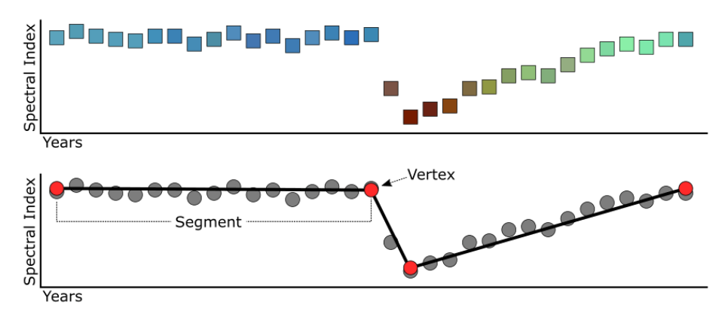
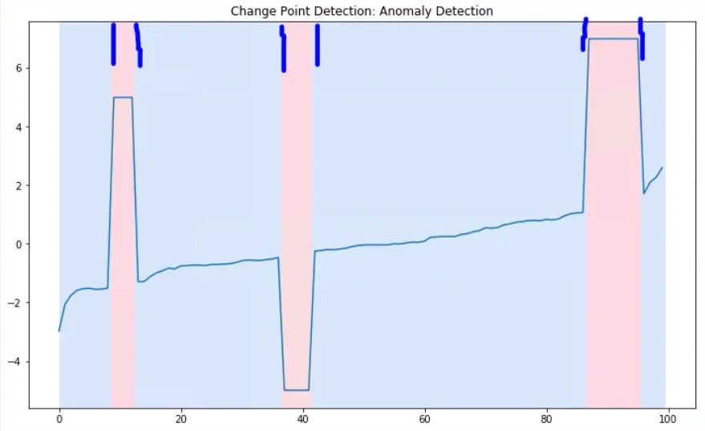
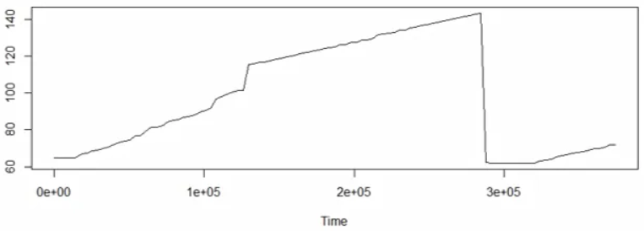
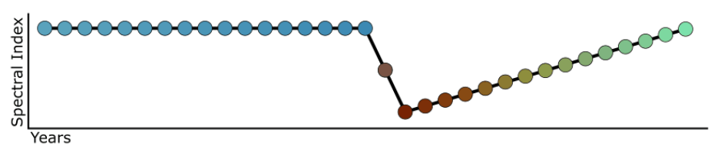
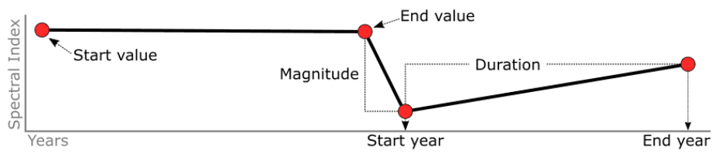
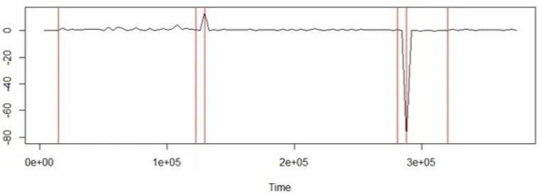
Trend and Change-Point Detection Methods for Remote Sensing Data
Trends
Change point detection

Slide 9
Image collection and methodology

Slide 10
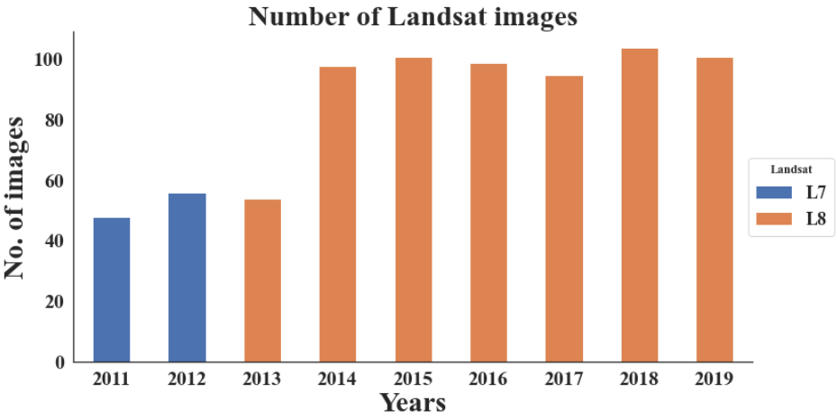
Number images for the study

Slide 11
Methodology
Colección de datos
Imágenes 2011 - 2019
Encuesta PATCA 2011-2019
Pre-proceso imágenes
correcion datos 2011 - línea base
Procesamiento de imágenes
Mascara de nubes
Datos de tierra
Recorte zona estudio
Creación índices
Comparación 2014 - 2019
Extracción de características
Métodos de tendencias y DPC*
Validación
Resultados de tendencias y DPC
*DPC: Detección de puntos de cambio

Slide 12
Trends 2011 – 2014 for one point

Slide 13
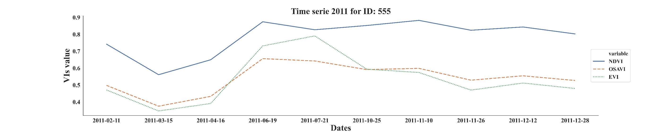
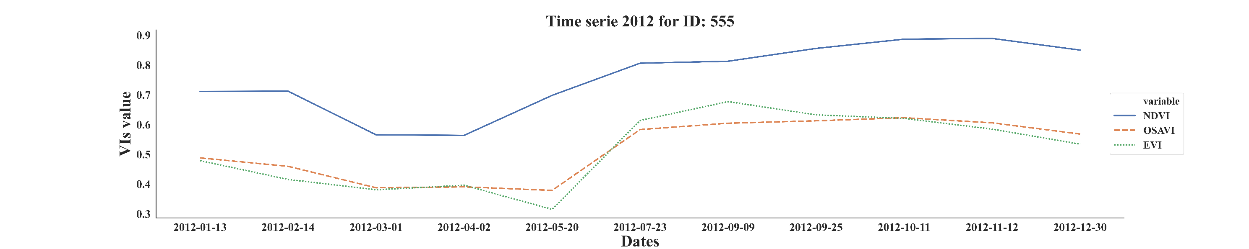
Trends for one point

Slide 14
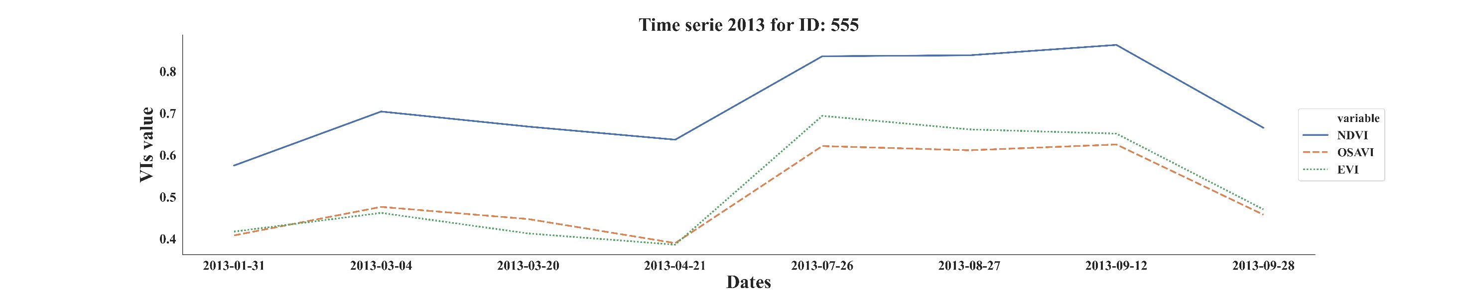
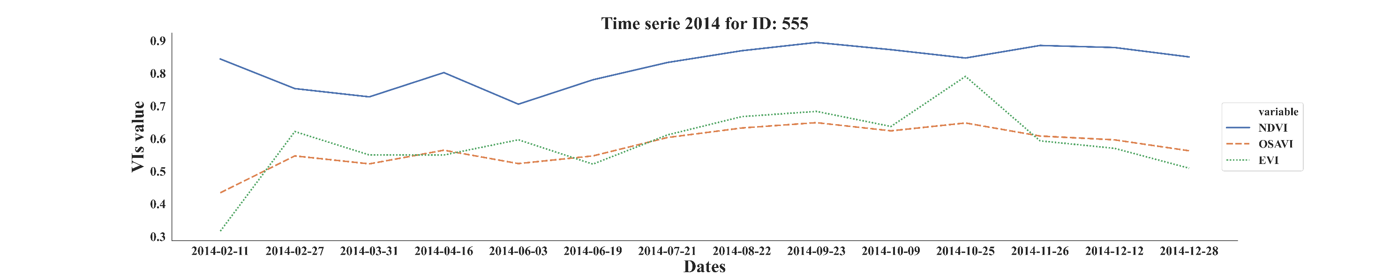
Trends for one point

Slide 15
Comparison with the survey
Cuest Id | Time | Parcela | Cultivo | Temporary Crop | Age | Gender | Superf Parcela Has | Month Siembra | Year Siembra | Since Siembra | Treat Status Fu | Patca
555 | 0. Baseline | 11 | Mango | 0 | 51 | Male | 5.5963192 | Abril | 2005 | 2005 | 0. Pure Control | 0
555 | 1. Follow-up1 | 11 | Plátano | 0 | 53 | Male | 5.5963192 | Septiembre | 2014 | 1996 | 0. Pure Control | 0

Slide 16
What's next?
We will continue the pre-processing of images Landsat 2015 - 2019
We will continue with the cloud mask 2015 - 2019
We will extract features of images (2011 - 2019)
We will create landtrendr, Mann-kendall, meanvar,
We will analyze the result of methods

